Slide 1
SSL for Beginners
Arduino SSL GCP-IoTCore MQTT
John F. Davis
GDG Southern Region DevFest 2021

Slide 2
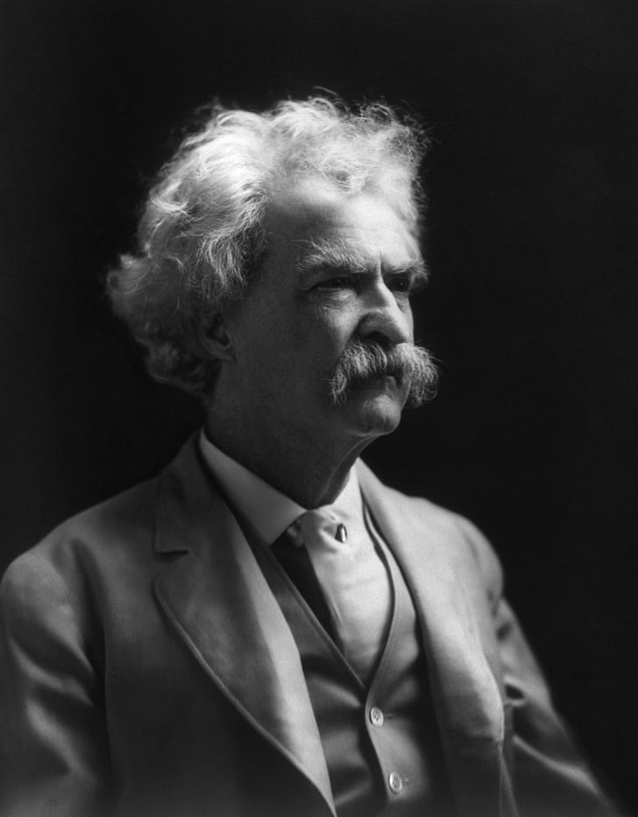
What’s this talk about?
My pal asked me to help him with his problem
I had resolved this before, some prior experience with SSL/TLS
My pal got a work around
I kept at it
I wanted to understand more
I figured it out
I want you to have an easier time than I

Slide 3
Overview
Part 1 - Problem with MQTT/SSL connection to IoT Core via LTE
Part 2 - Learning how SSL works
Part 3 - Resolving the problem - Arduino Details

Slide 4
Part 1 - Problem with MQTT/SSL connection to IoT Core via LTE
What’s the problem exactly?
Can you draw a picture?
How do you start?
What does it look like in GCP?
Does it work?

Slide 5
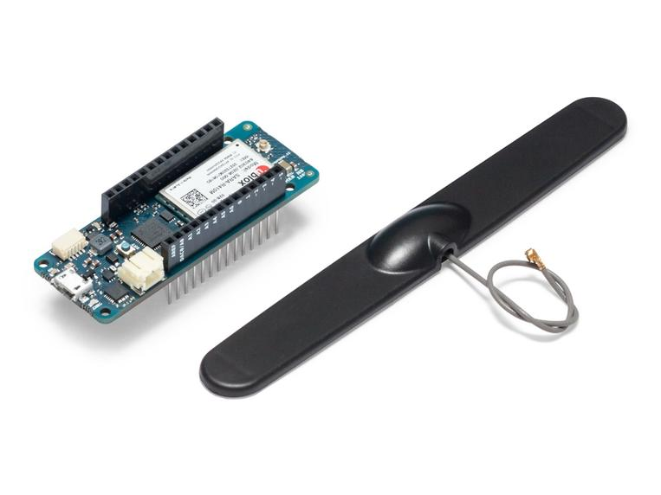
The problem
Devices which worked are no longer working. The devices used to connect successfully to Google IoT Core on GCP. The devices are a combination of open source hardware/software using LTE for communications.
Previously worked
Some construction required, but generally no problem
Now mysteriously does not work

Slide 6
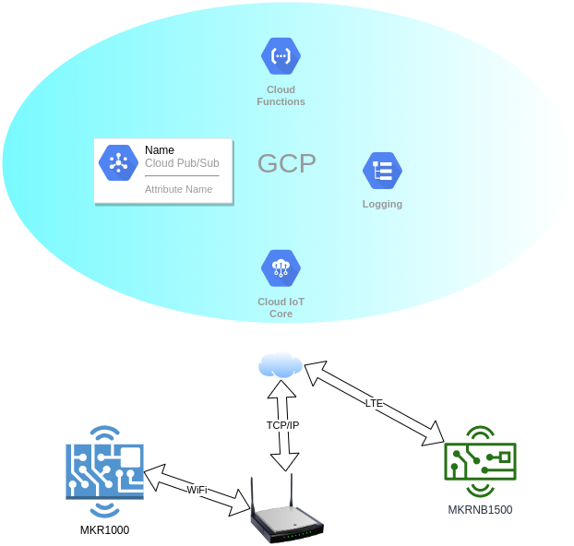

The situation

Slide 7
Solving the problem - step 0
How to reproduce? LTE or WiFi?
Similar SoC’s
Arm Cortex M0+
Different Manufacturers implementation - MicroChip vs Atmel
Can sniff WiFi

Slide 8
Common Settings - Step 0+
Generate a key, add to device firmware, add public key to IoT Core for a particular device. Ensure settings on key are correct. Eg. es256 vs es256_x509
Add root and intermediate cert to stack - varies based upon hardware and stack.
LTE - add hex bytes to ublox
WiFi
  arduino hardware implementation - certs are added via winc1500 and jwt is generated via ecxx08
  Google software implementation - certs/jwt are added as hex bytes and stack implemented via software

Slide 9
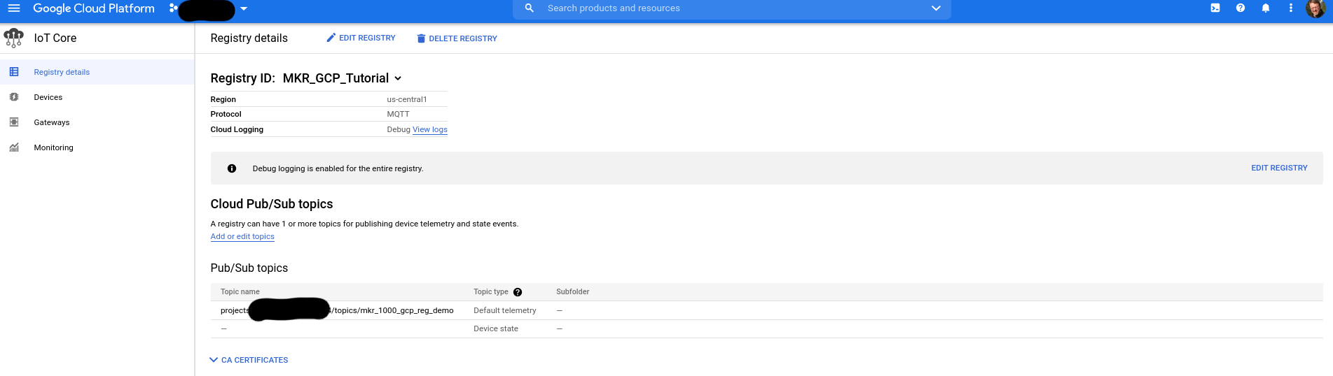
GCP IoT Core - Registry
Notes:
Mention 509 wrapper might use the ca cert for the registry

Slide 10
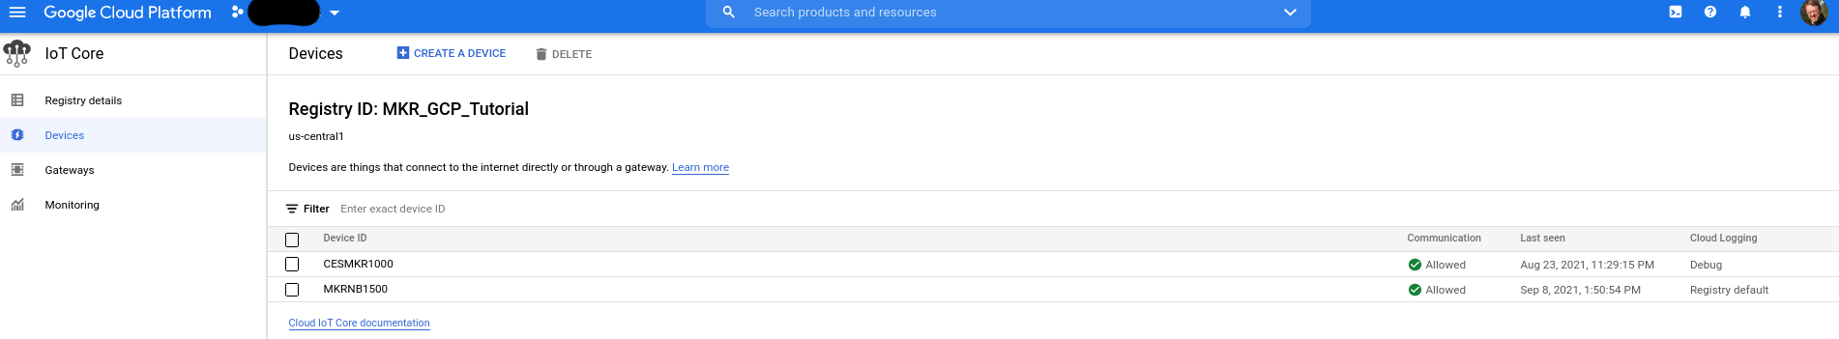
GCP IoT Core - Devices

Slide 11
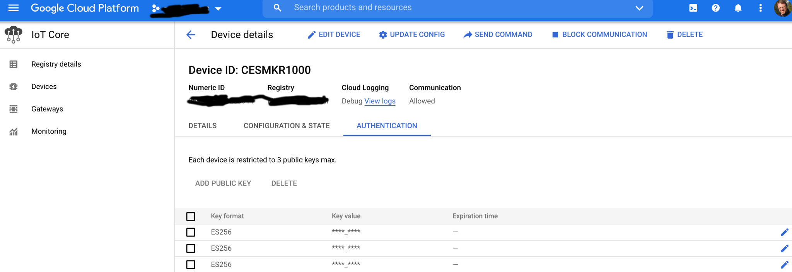
GCP IoT Core - Device Detail

Slide 12
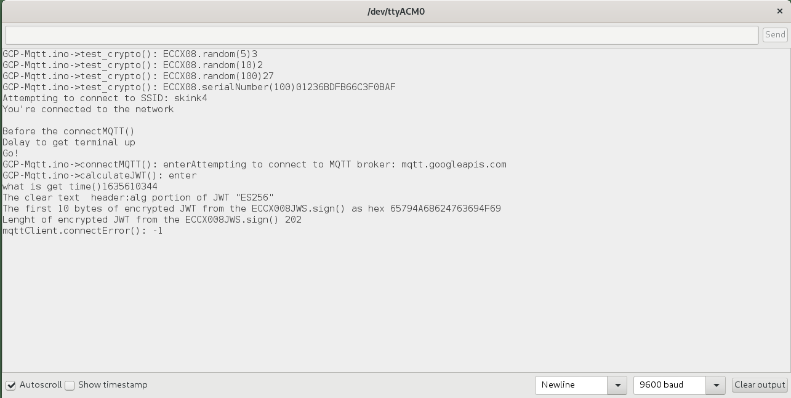

Do all the things and then Error

Slide 13
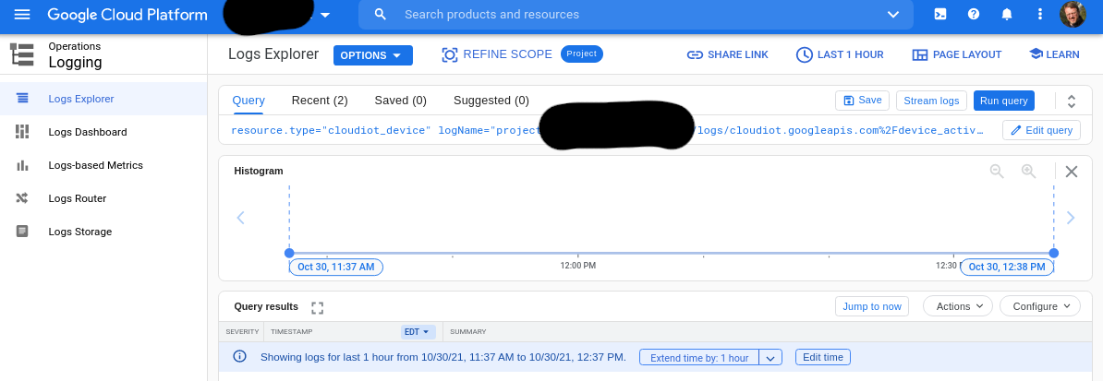

Logs

Slide 14
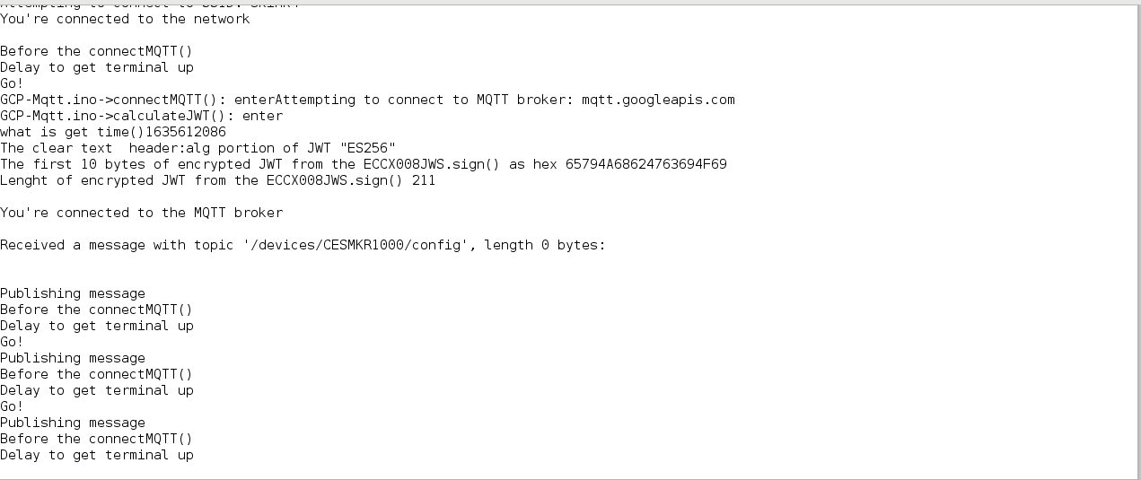

Success!

Slide 15
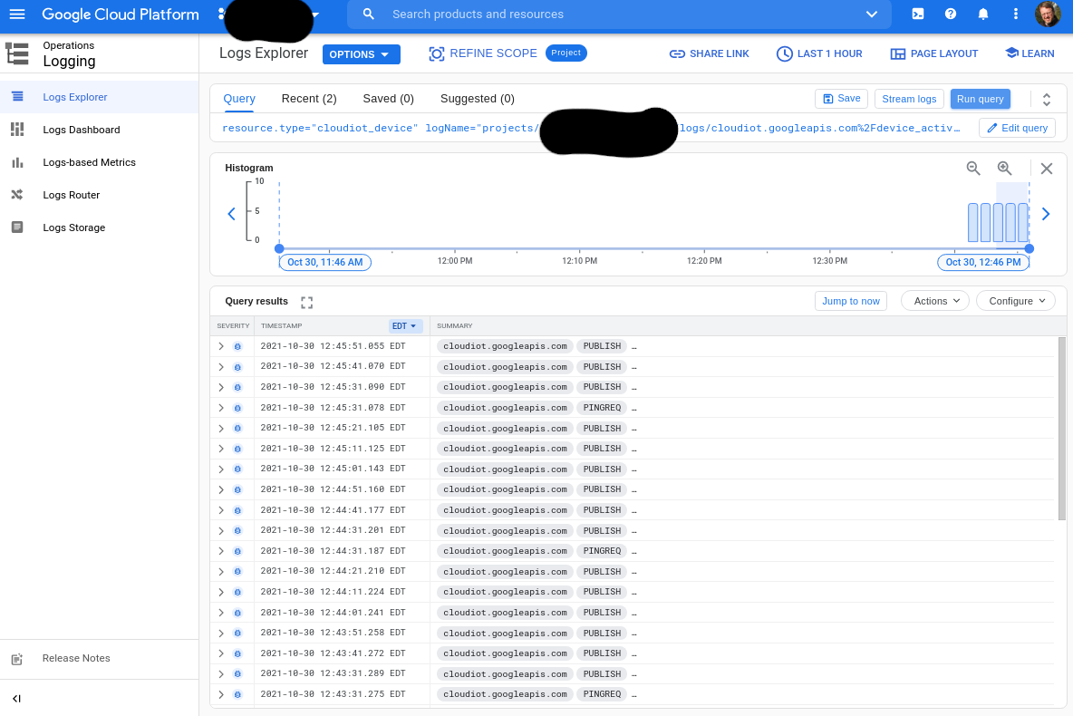

Success! Logs

Slide 16
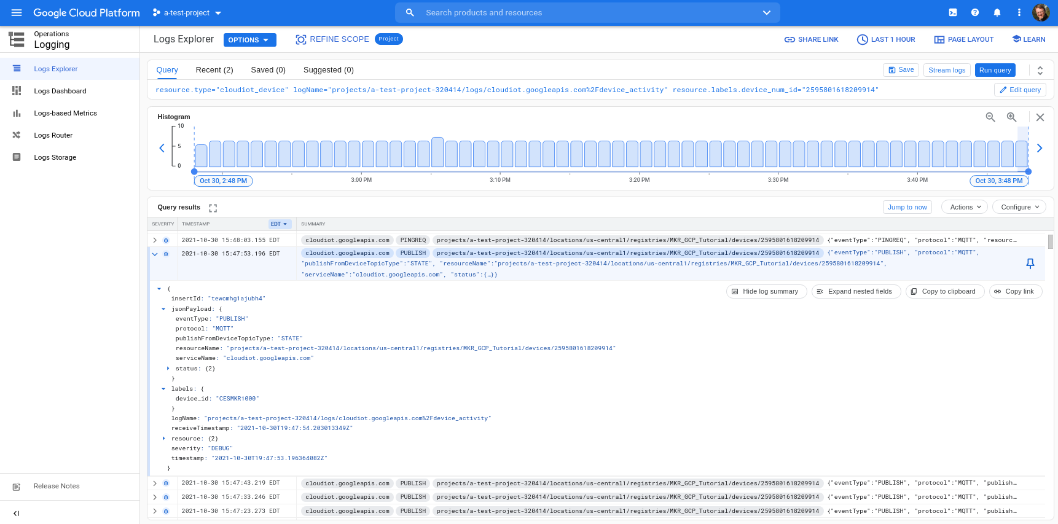
Log Detail

Slide 17
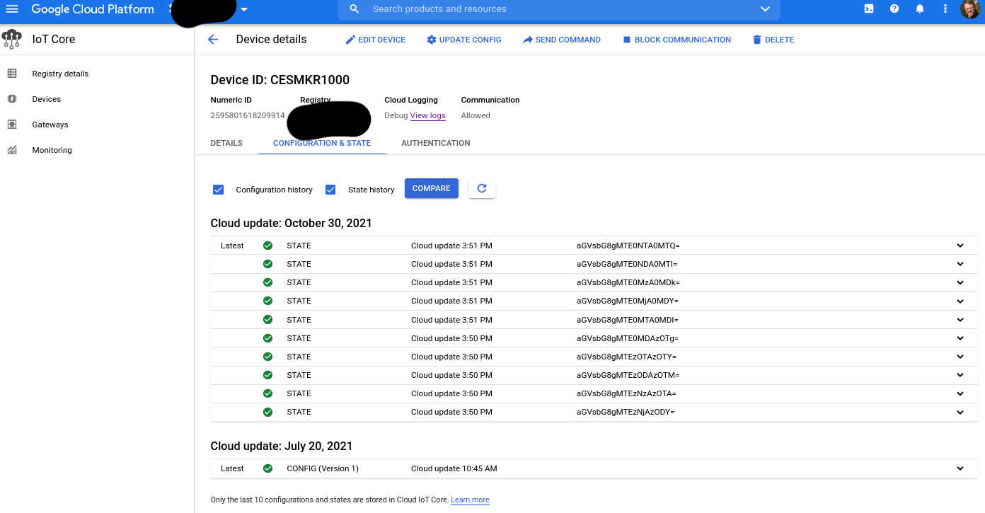
IoT Core Device State

Slide 18
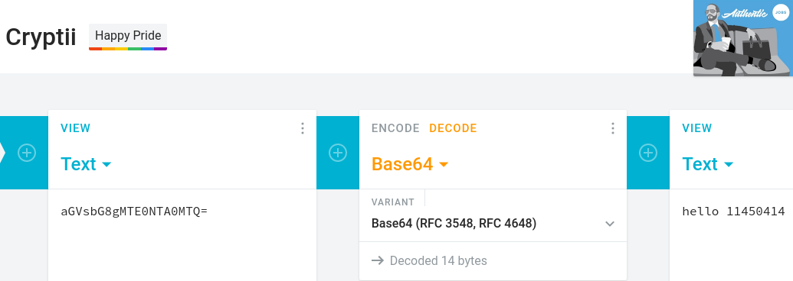
Base64

Slide 19
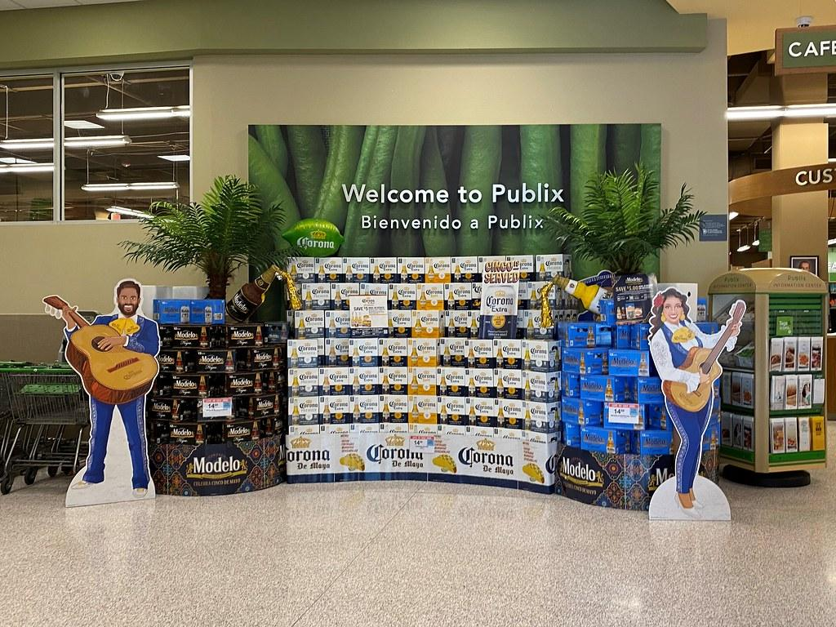
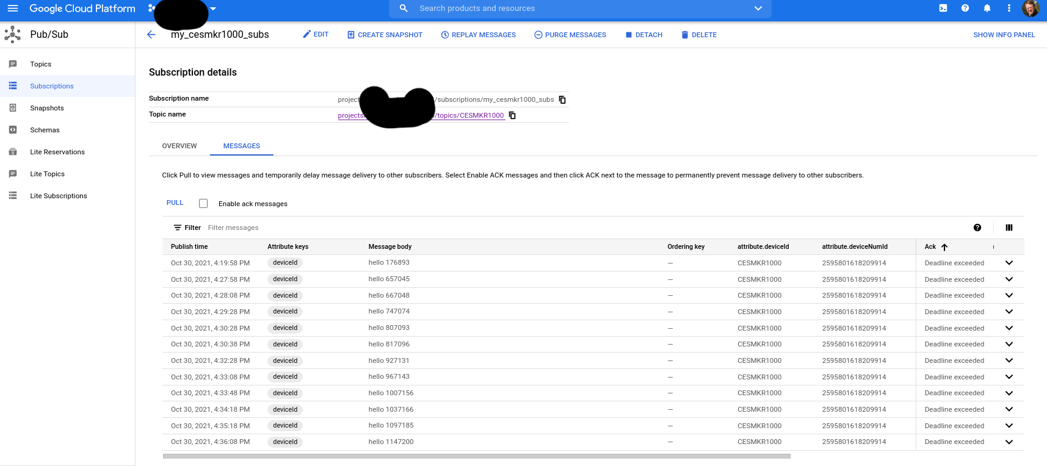
Pub/Sub

Slide 20
Part 2 - Learning how SSL works
Chain of trust
Cert locations
File types
Specs
Openssl commands
Other commands
Illustrated tls
tcpdump/wireshark/pcap analysis
Encryption

Slide 21
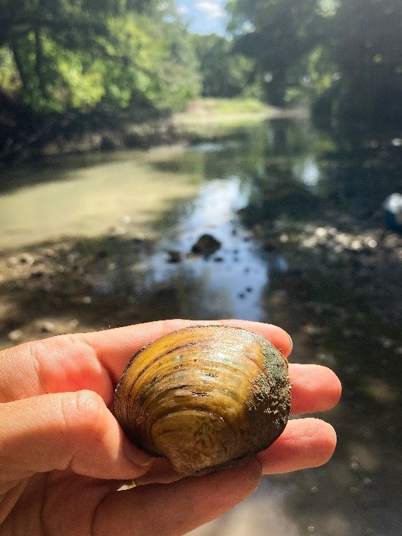
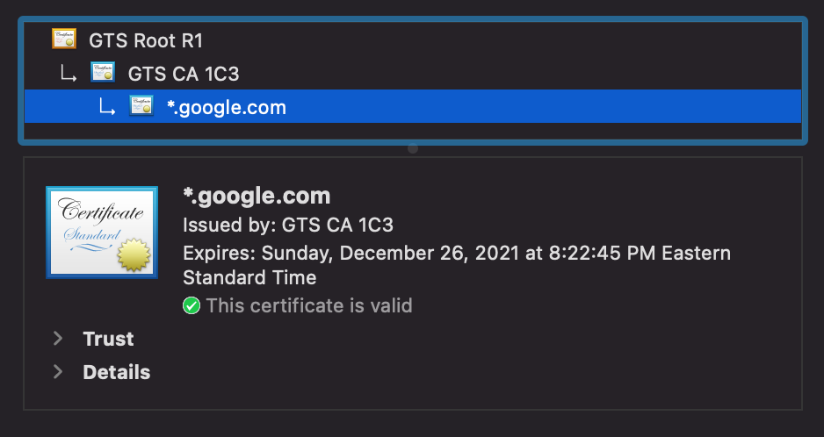
Chain of Trust

Slide 22
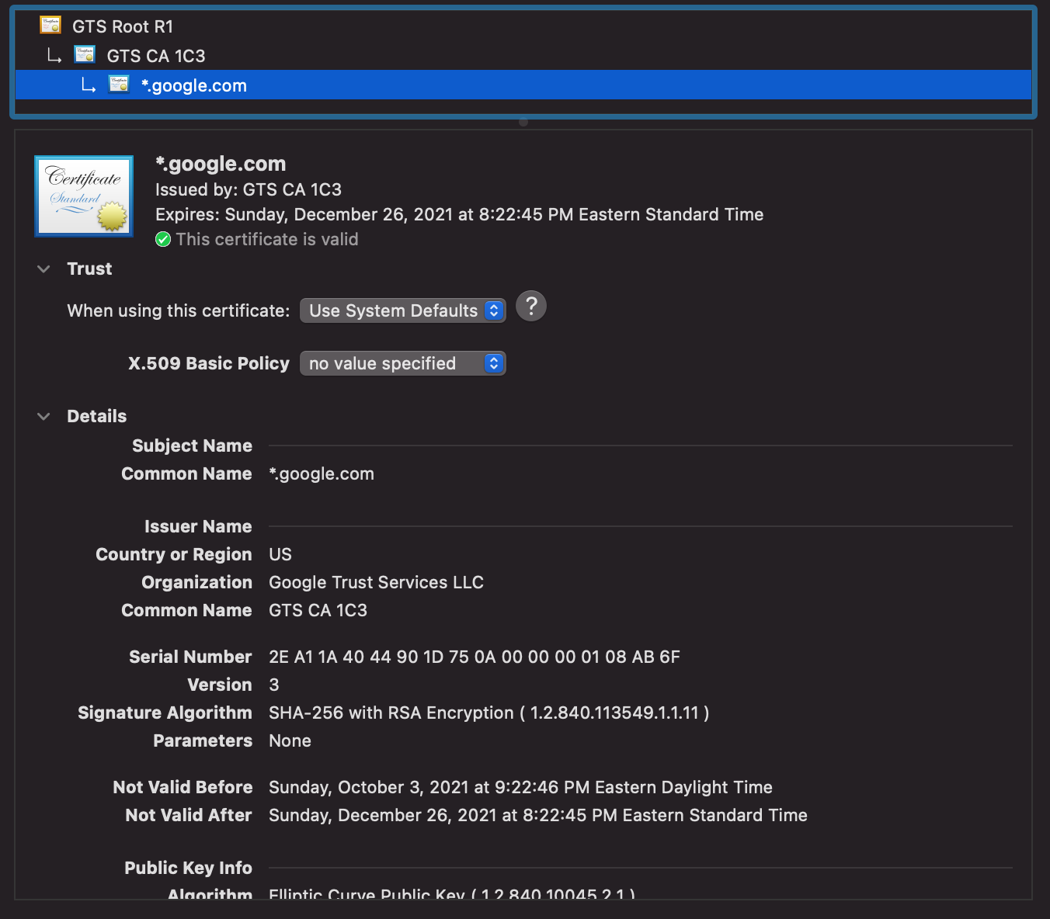
Server Certificate

Slide 23
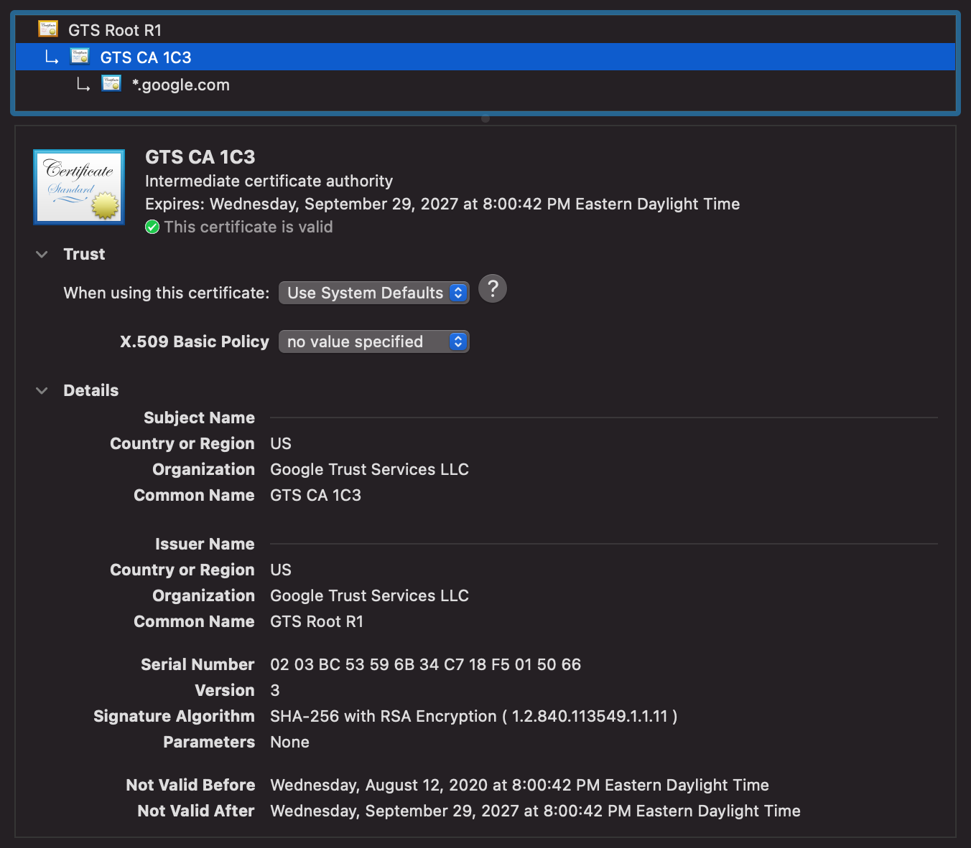
Intermediate Certificate

Slide 24
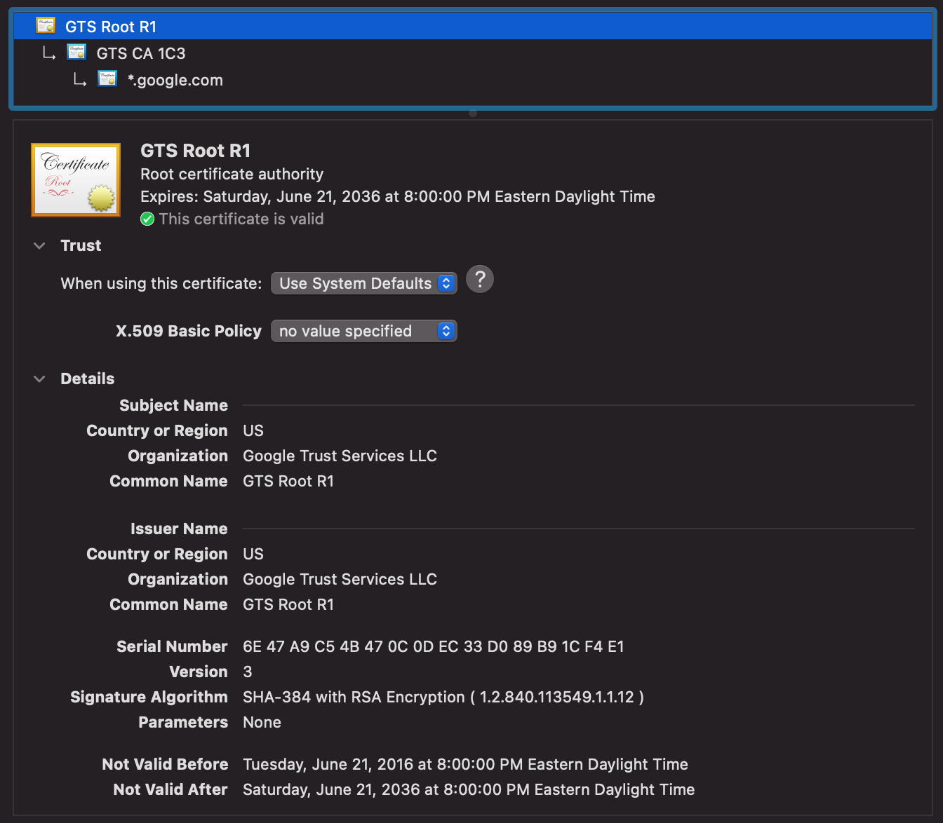
Root Certificate

Slide 25
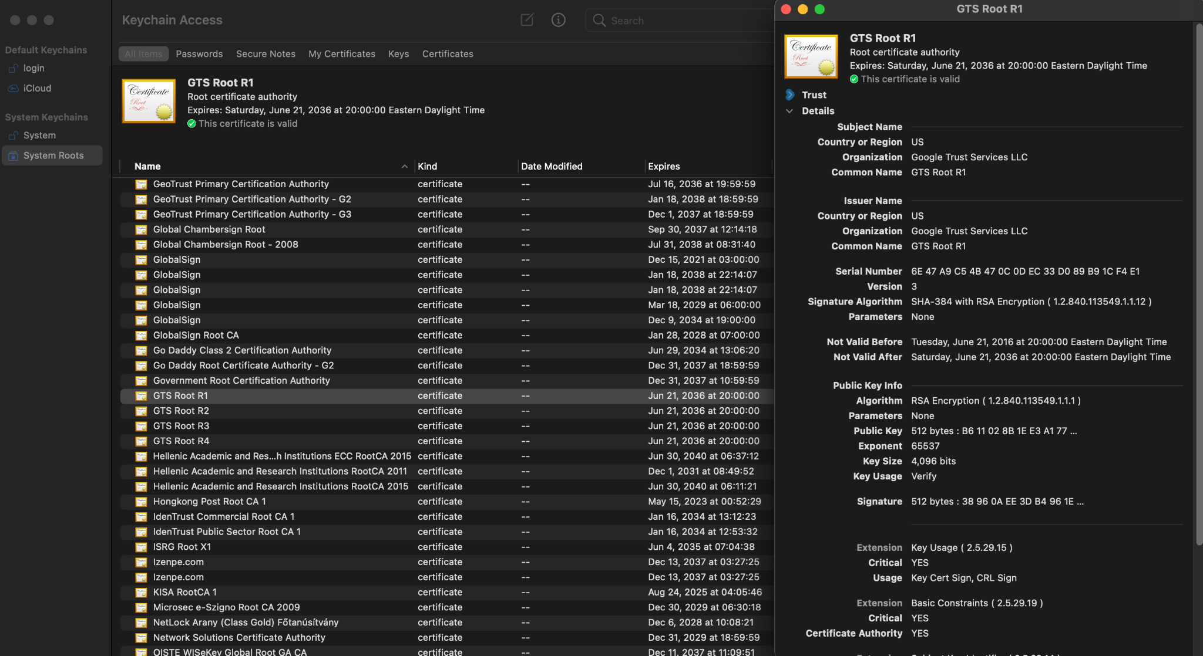
OSX - Keychain Access

Slide 26
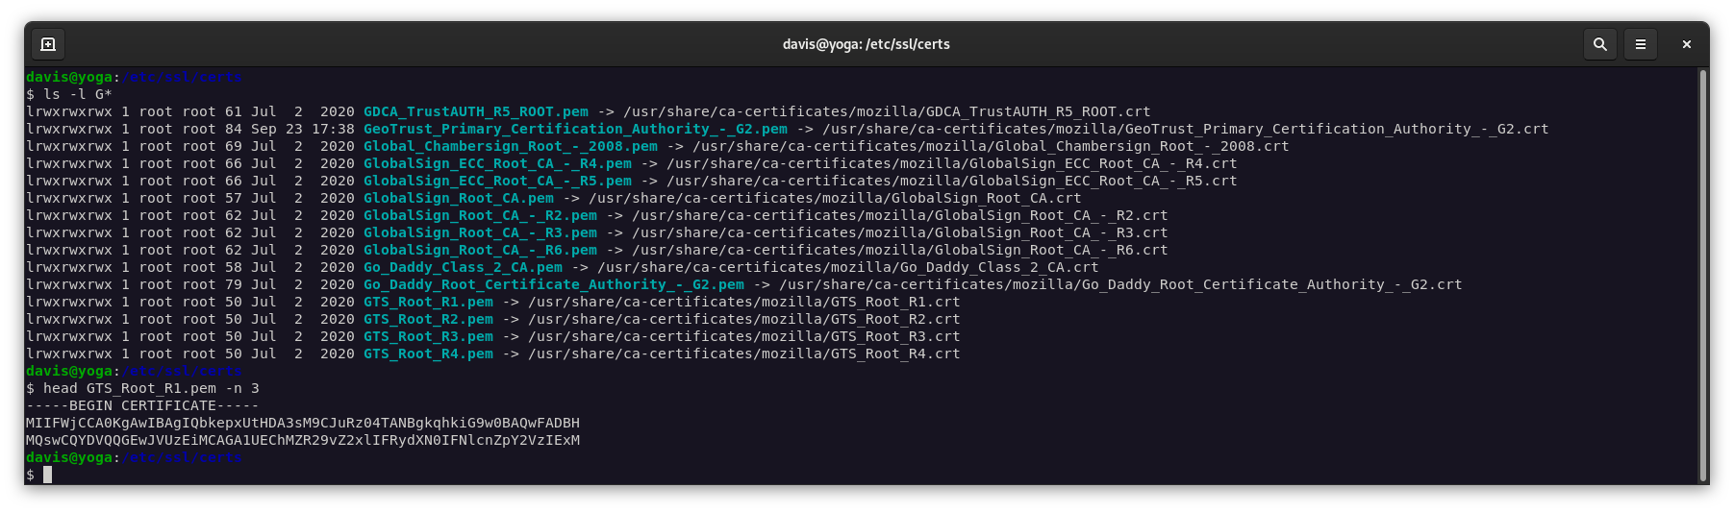
Linux - /etc/ssl/certs

Slide 27
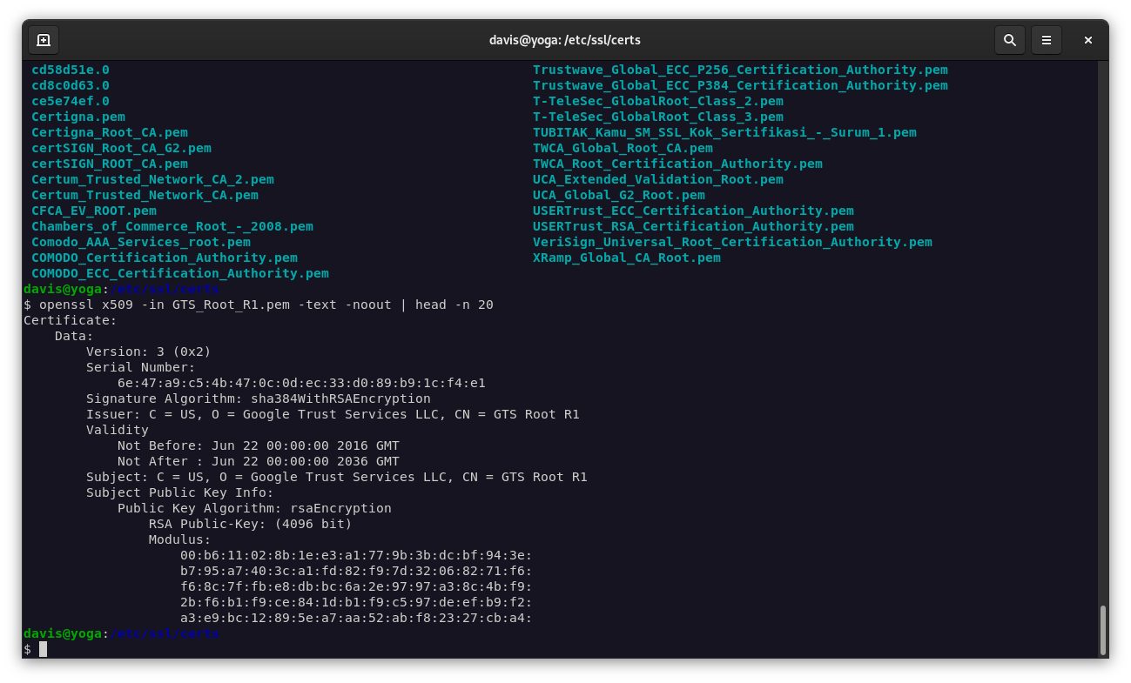
Examine a PEM file
$ openssl x509 -in <filename> -text -noout

Slide 28
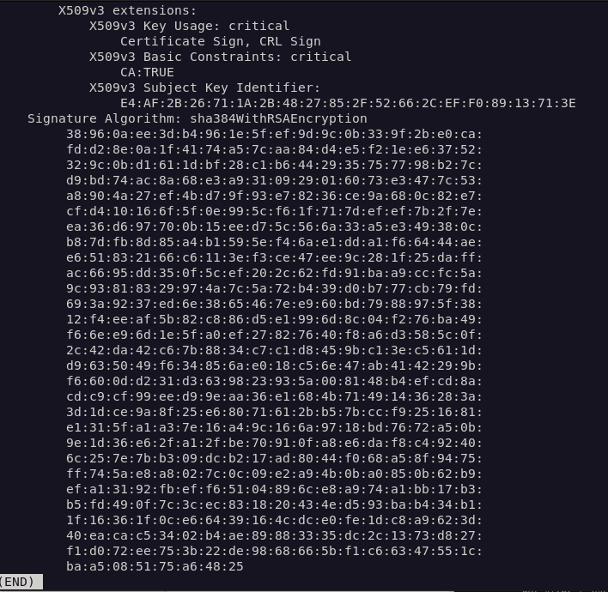
Pem file examination with openssl continued

Slide 29
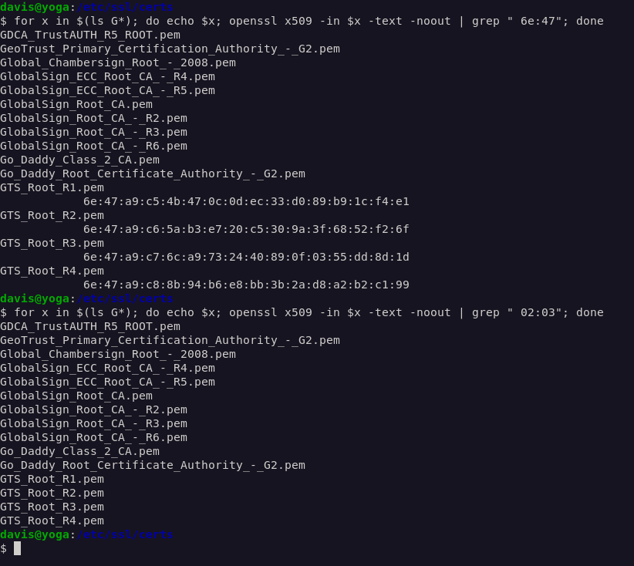
What about that intermediate certificate?

Slide 30
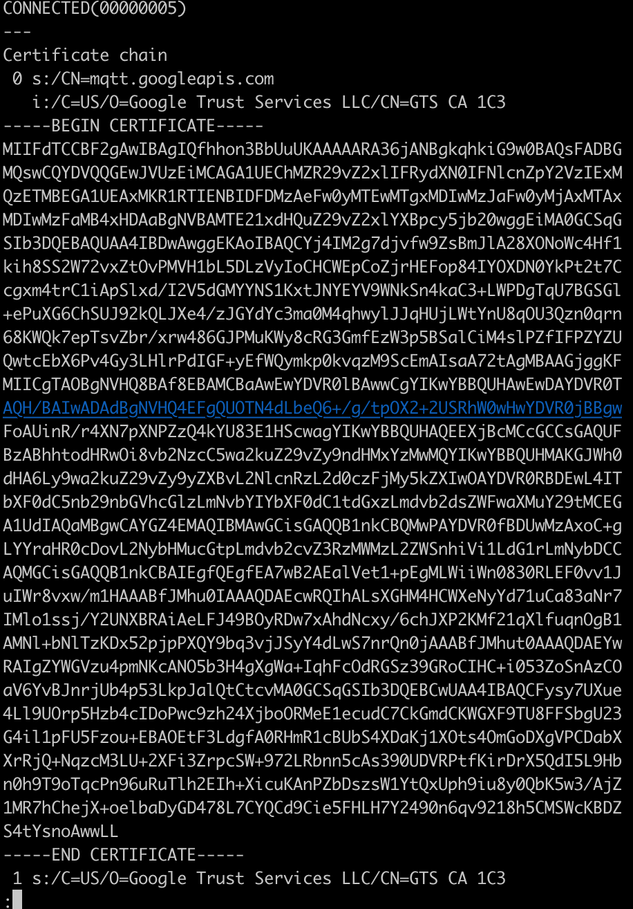
Examining the server
openssl s_client -showcerts mqtt.googleapis.com:8883
openssl s_client -showcerts -connect mqtt.googleapis.com:8883
OSX

Slide 31
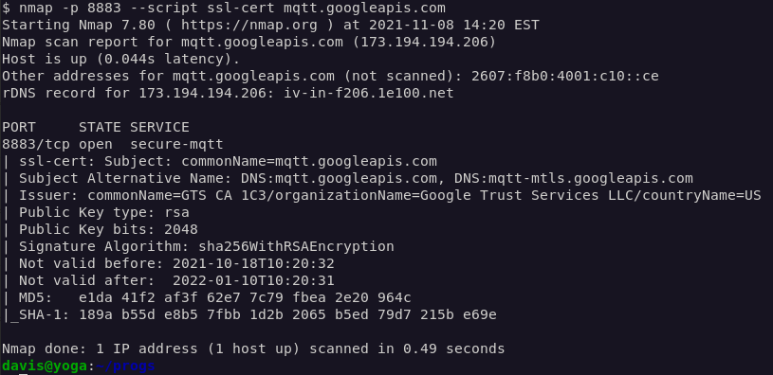
Other commands
Demo
openssl s_client -showcerts -servername mqtt.googleapis.com:8883 -connect mqtt.2030.ltsapis.goog:8883 </dev/null
nmap -p 8883 --script ssl-cert mqtt.googleapis.com

Slide 32
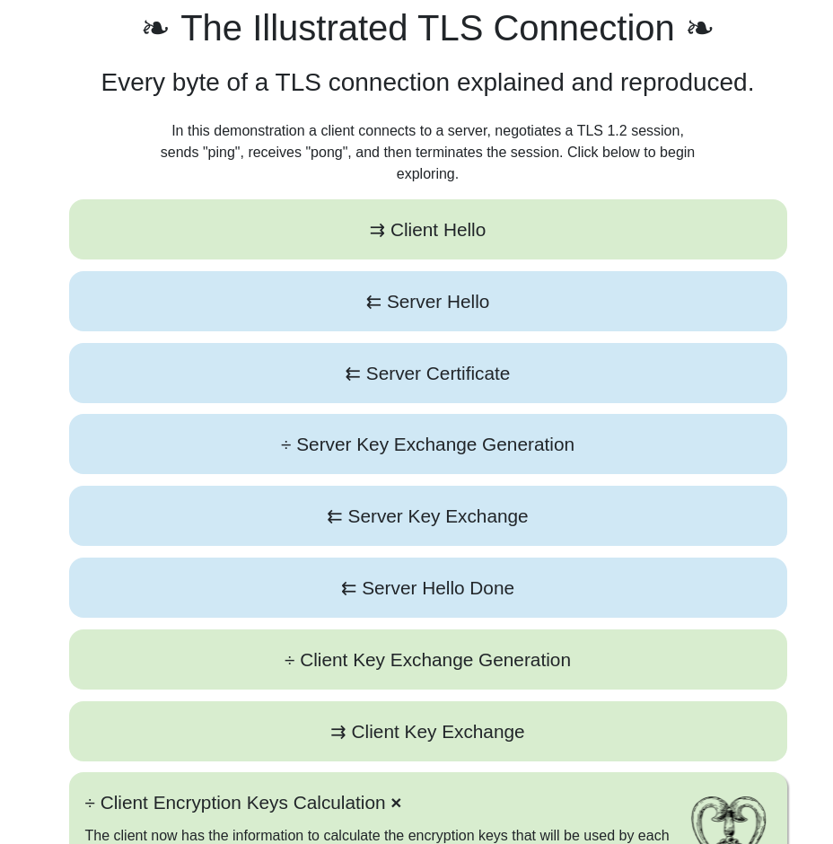

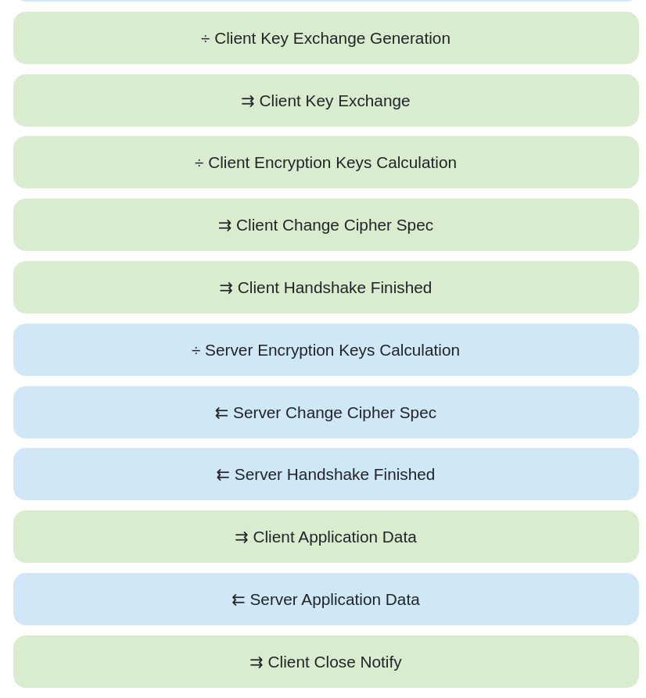
https://tls.ulfheim.net/
Notes:
Show the openssl command. Show the verify step. Show the diffie hellman key generation. Show

Slide 33
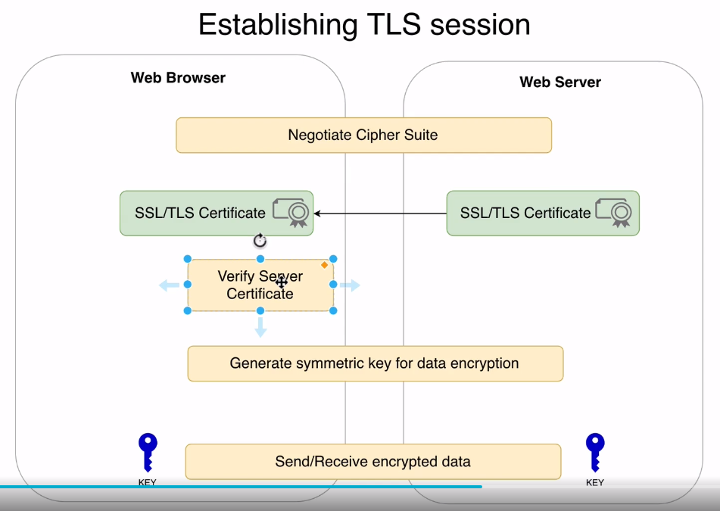
SSL Complete Guide 2021: HTTP to HTTPS
By Bogdan Stashchuk

Slide 34

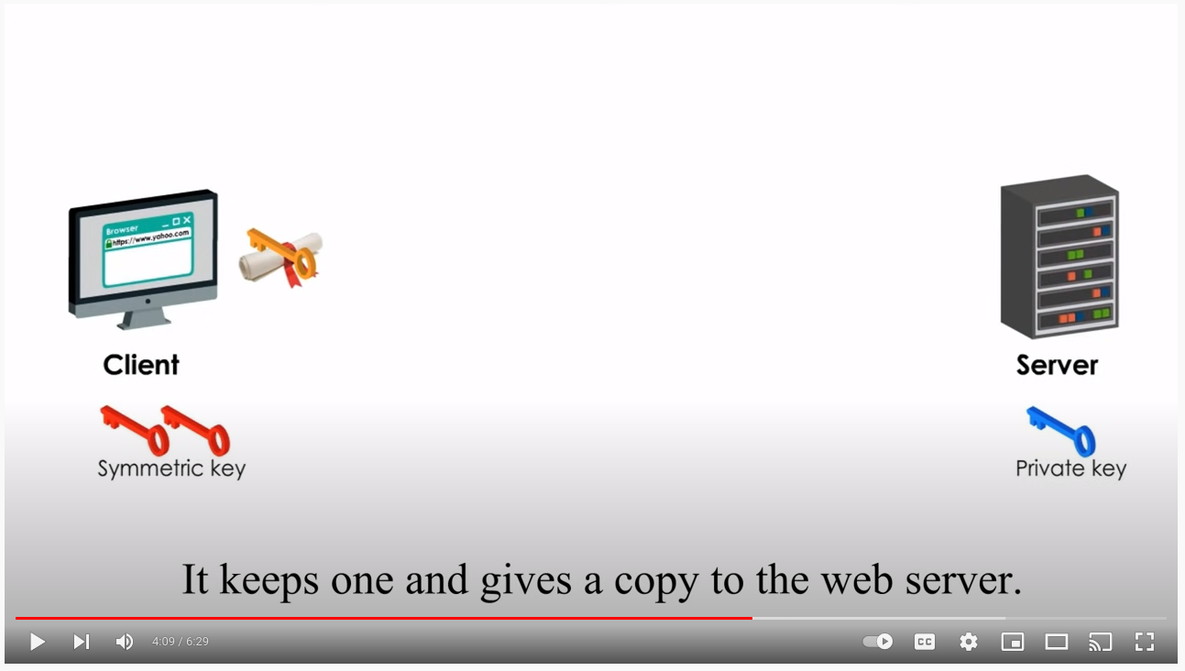
Aside

Slide 35
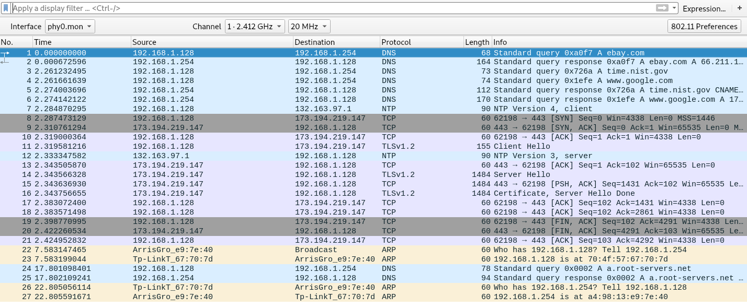
HTTPS Failure

Slide 36
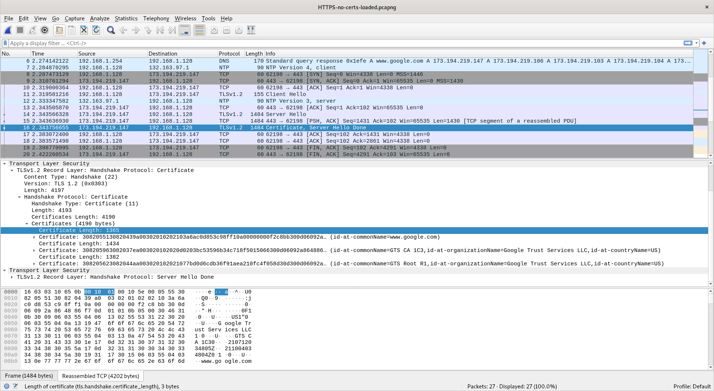

Slide 37
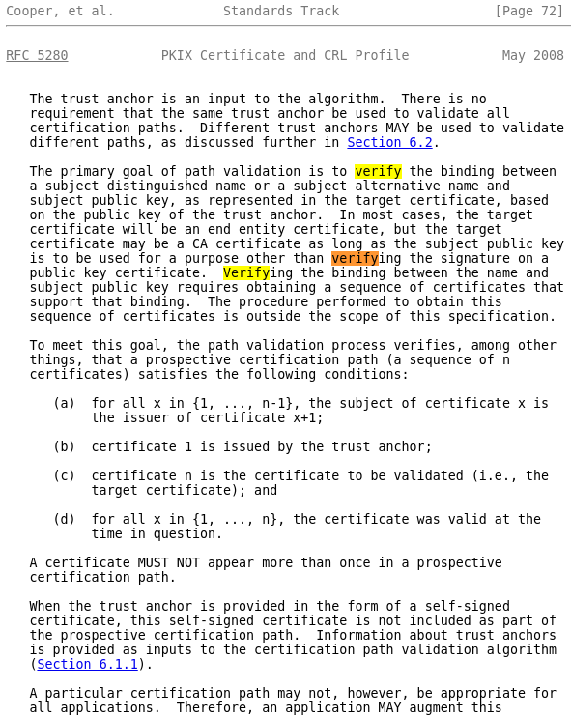
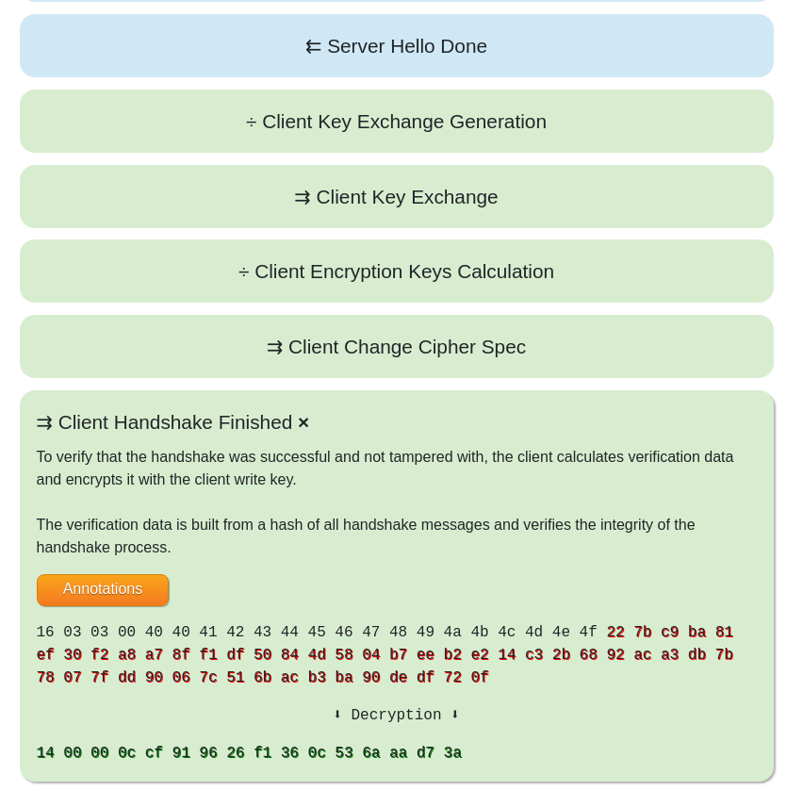
Hmm, Server “sends hello done” and client closes?

Slide 38
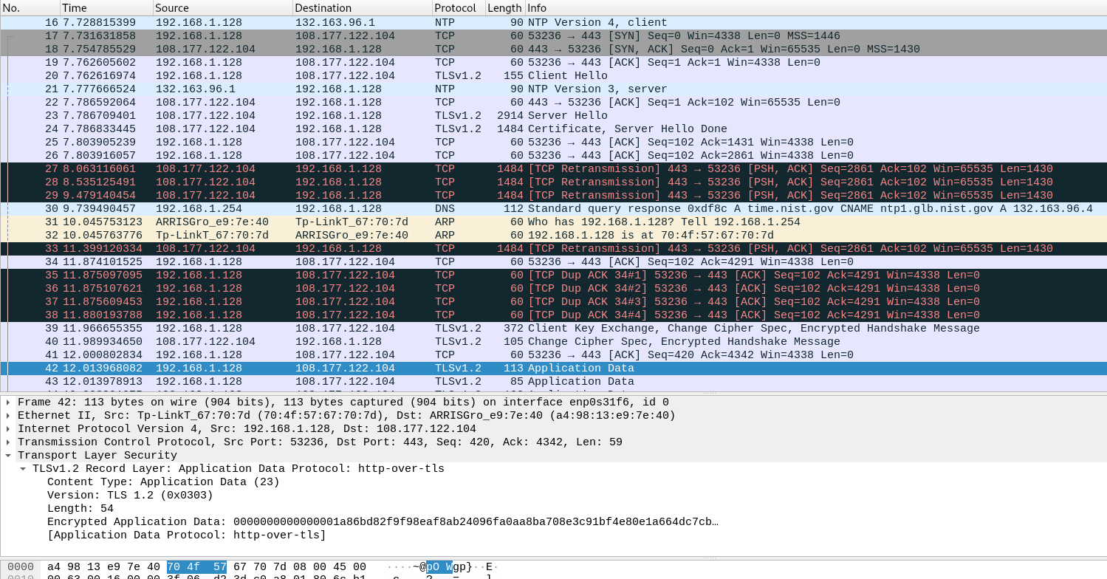
HTTPS Success

Slide 39
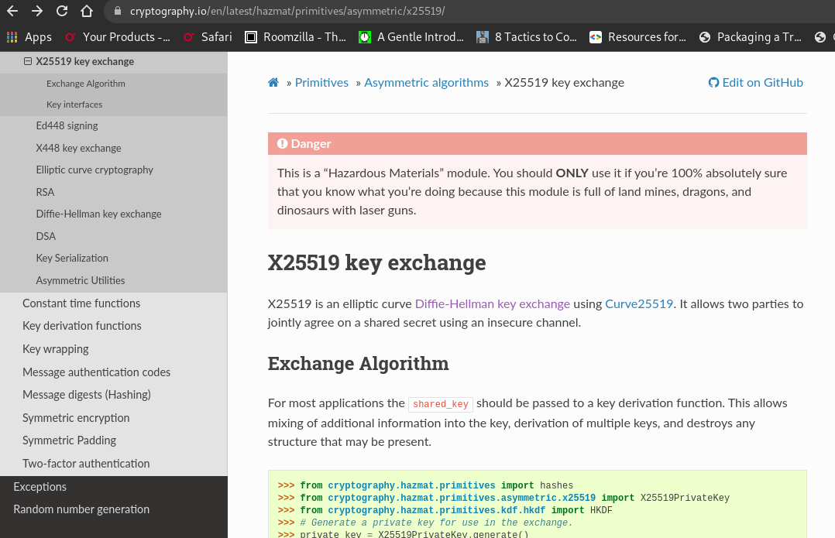
Key Exchange

Slide 40
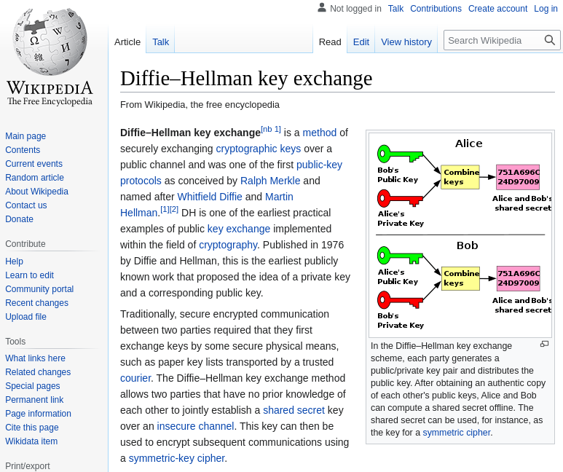
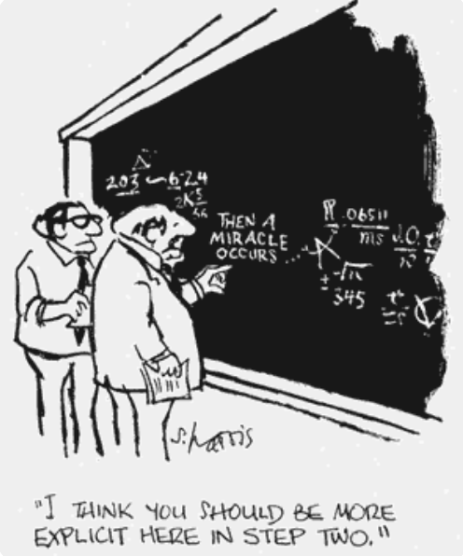
Key Exchange

Slide 41
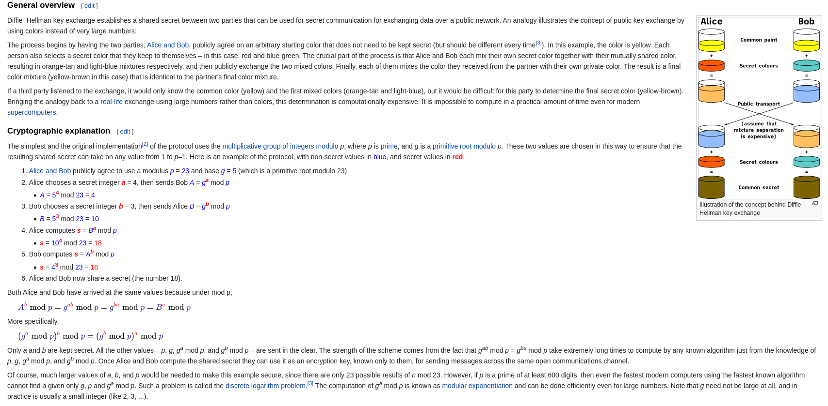
Key Exchange Diffie-Hellman

Slide 42

Network Captures
https://github.com/netskink/ssl_publy/blob/main/capture_dump.md

Slide 43
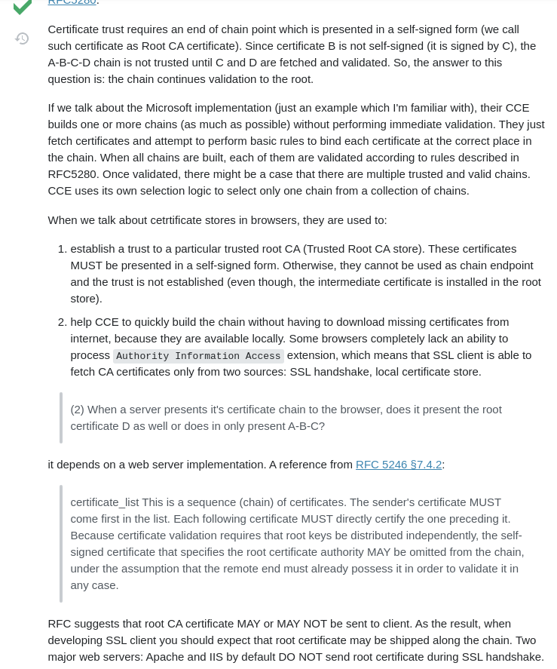
Stack Overflow

Slide 44
Part 3 - Resolving the problem - Arduino Details
Google Help Sample
https://github.com/GoogleCloudPlatform/cpp-samples/blob/main/iot/mqtt-ciotc/mqtt_ciotc.c
Focus on WiFi implementation
https://github.com/GoogleCloudPlatform/google-cloud-iot-arduino
https://github.com/arduino/ArduinoCloudProviderExamples
The one used for analysis
ArduinoCloudProviderExamples/GCP_IoT_Core_WiFi.ino at master · arduino/ArduinoCloudProviderExamples · GitHub
Normal vs LTS URL
UBlox AT Command

Slide 45
Arduino Hardware Example
MKRNB or WiFi101
ArduinoMqttClient
Arduino_JSON
Ecc08

Slide 46
GCP Example
MKRNB or WiFi101
MQTT
Arduino iot cloud
Arduino cloud provider examples

Slide 47
Google Official Help Reference
https://cloud.google.com/iot/docs/how-tos/mqtt-bridge#downloading_mqtt_server_certificates

Slide 48
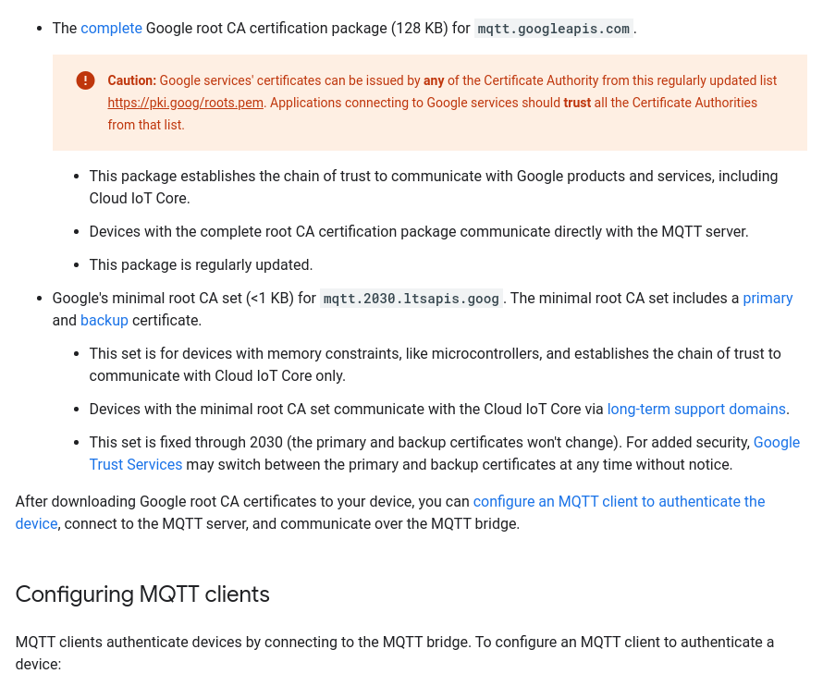
Google Help Entry

Slide 49
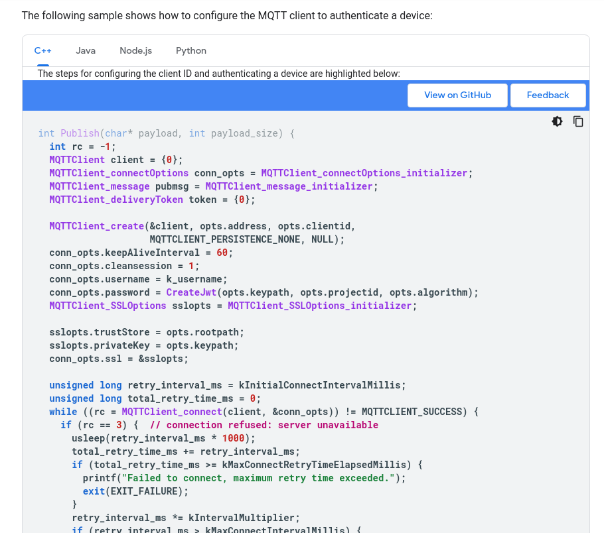
Google Official Code Sample

Slide 50
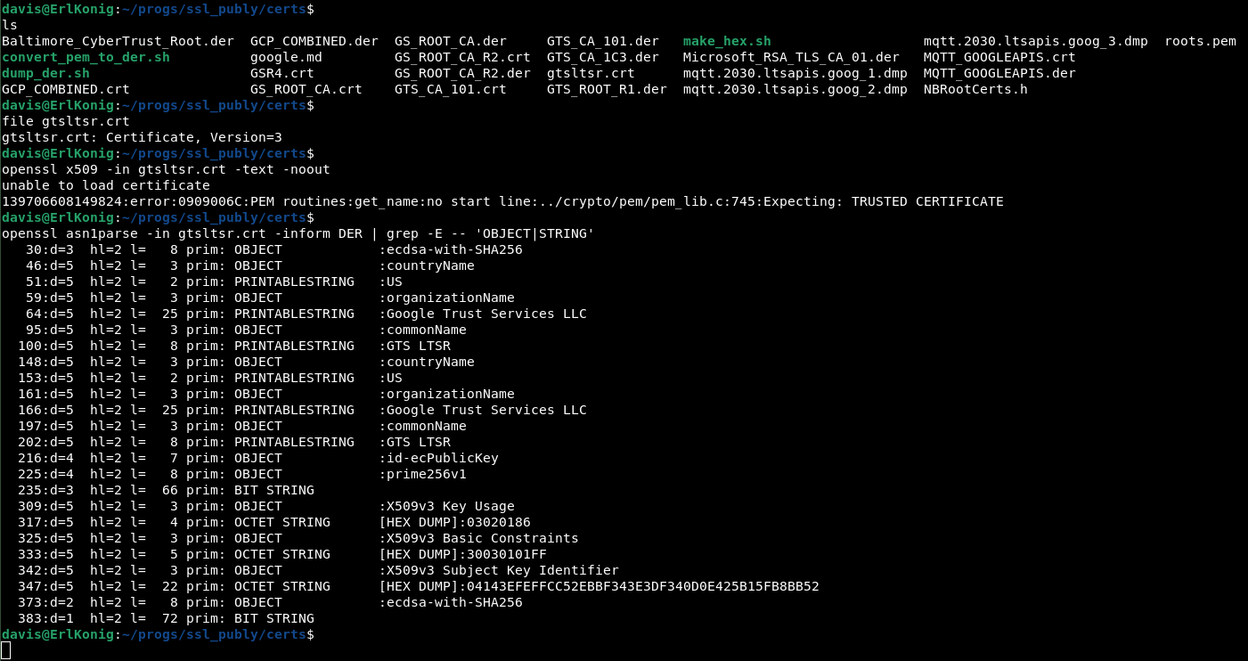
The LTS Certs

Slide 51
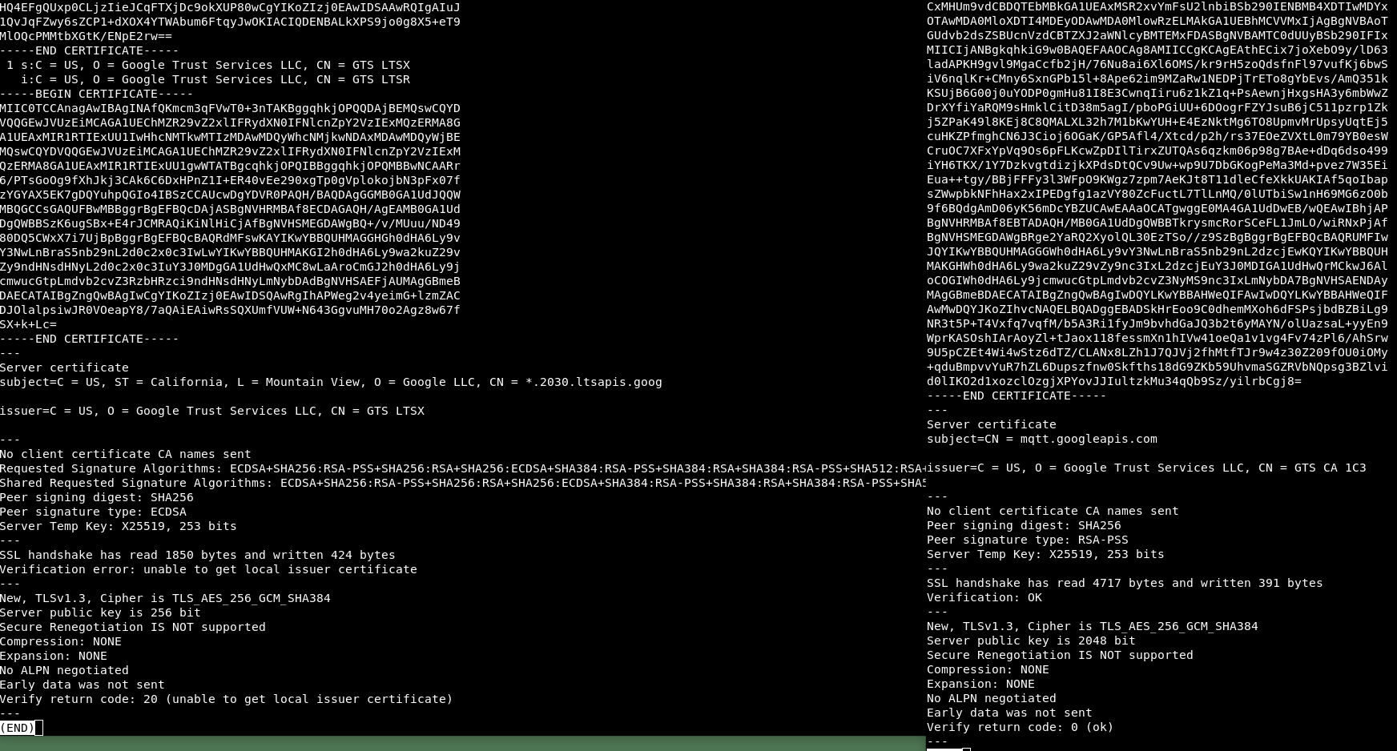
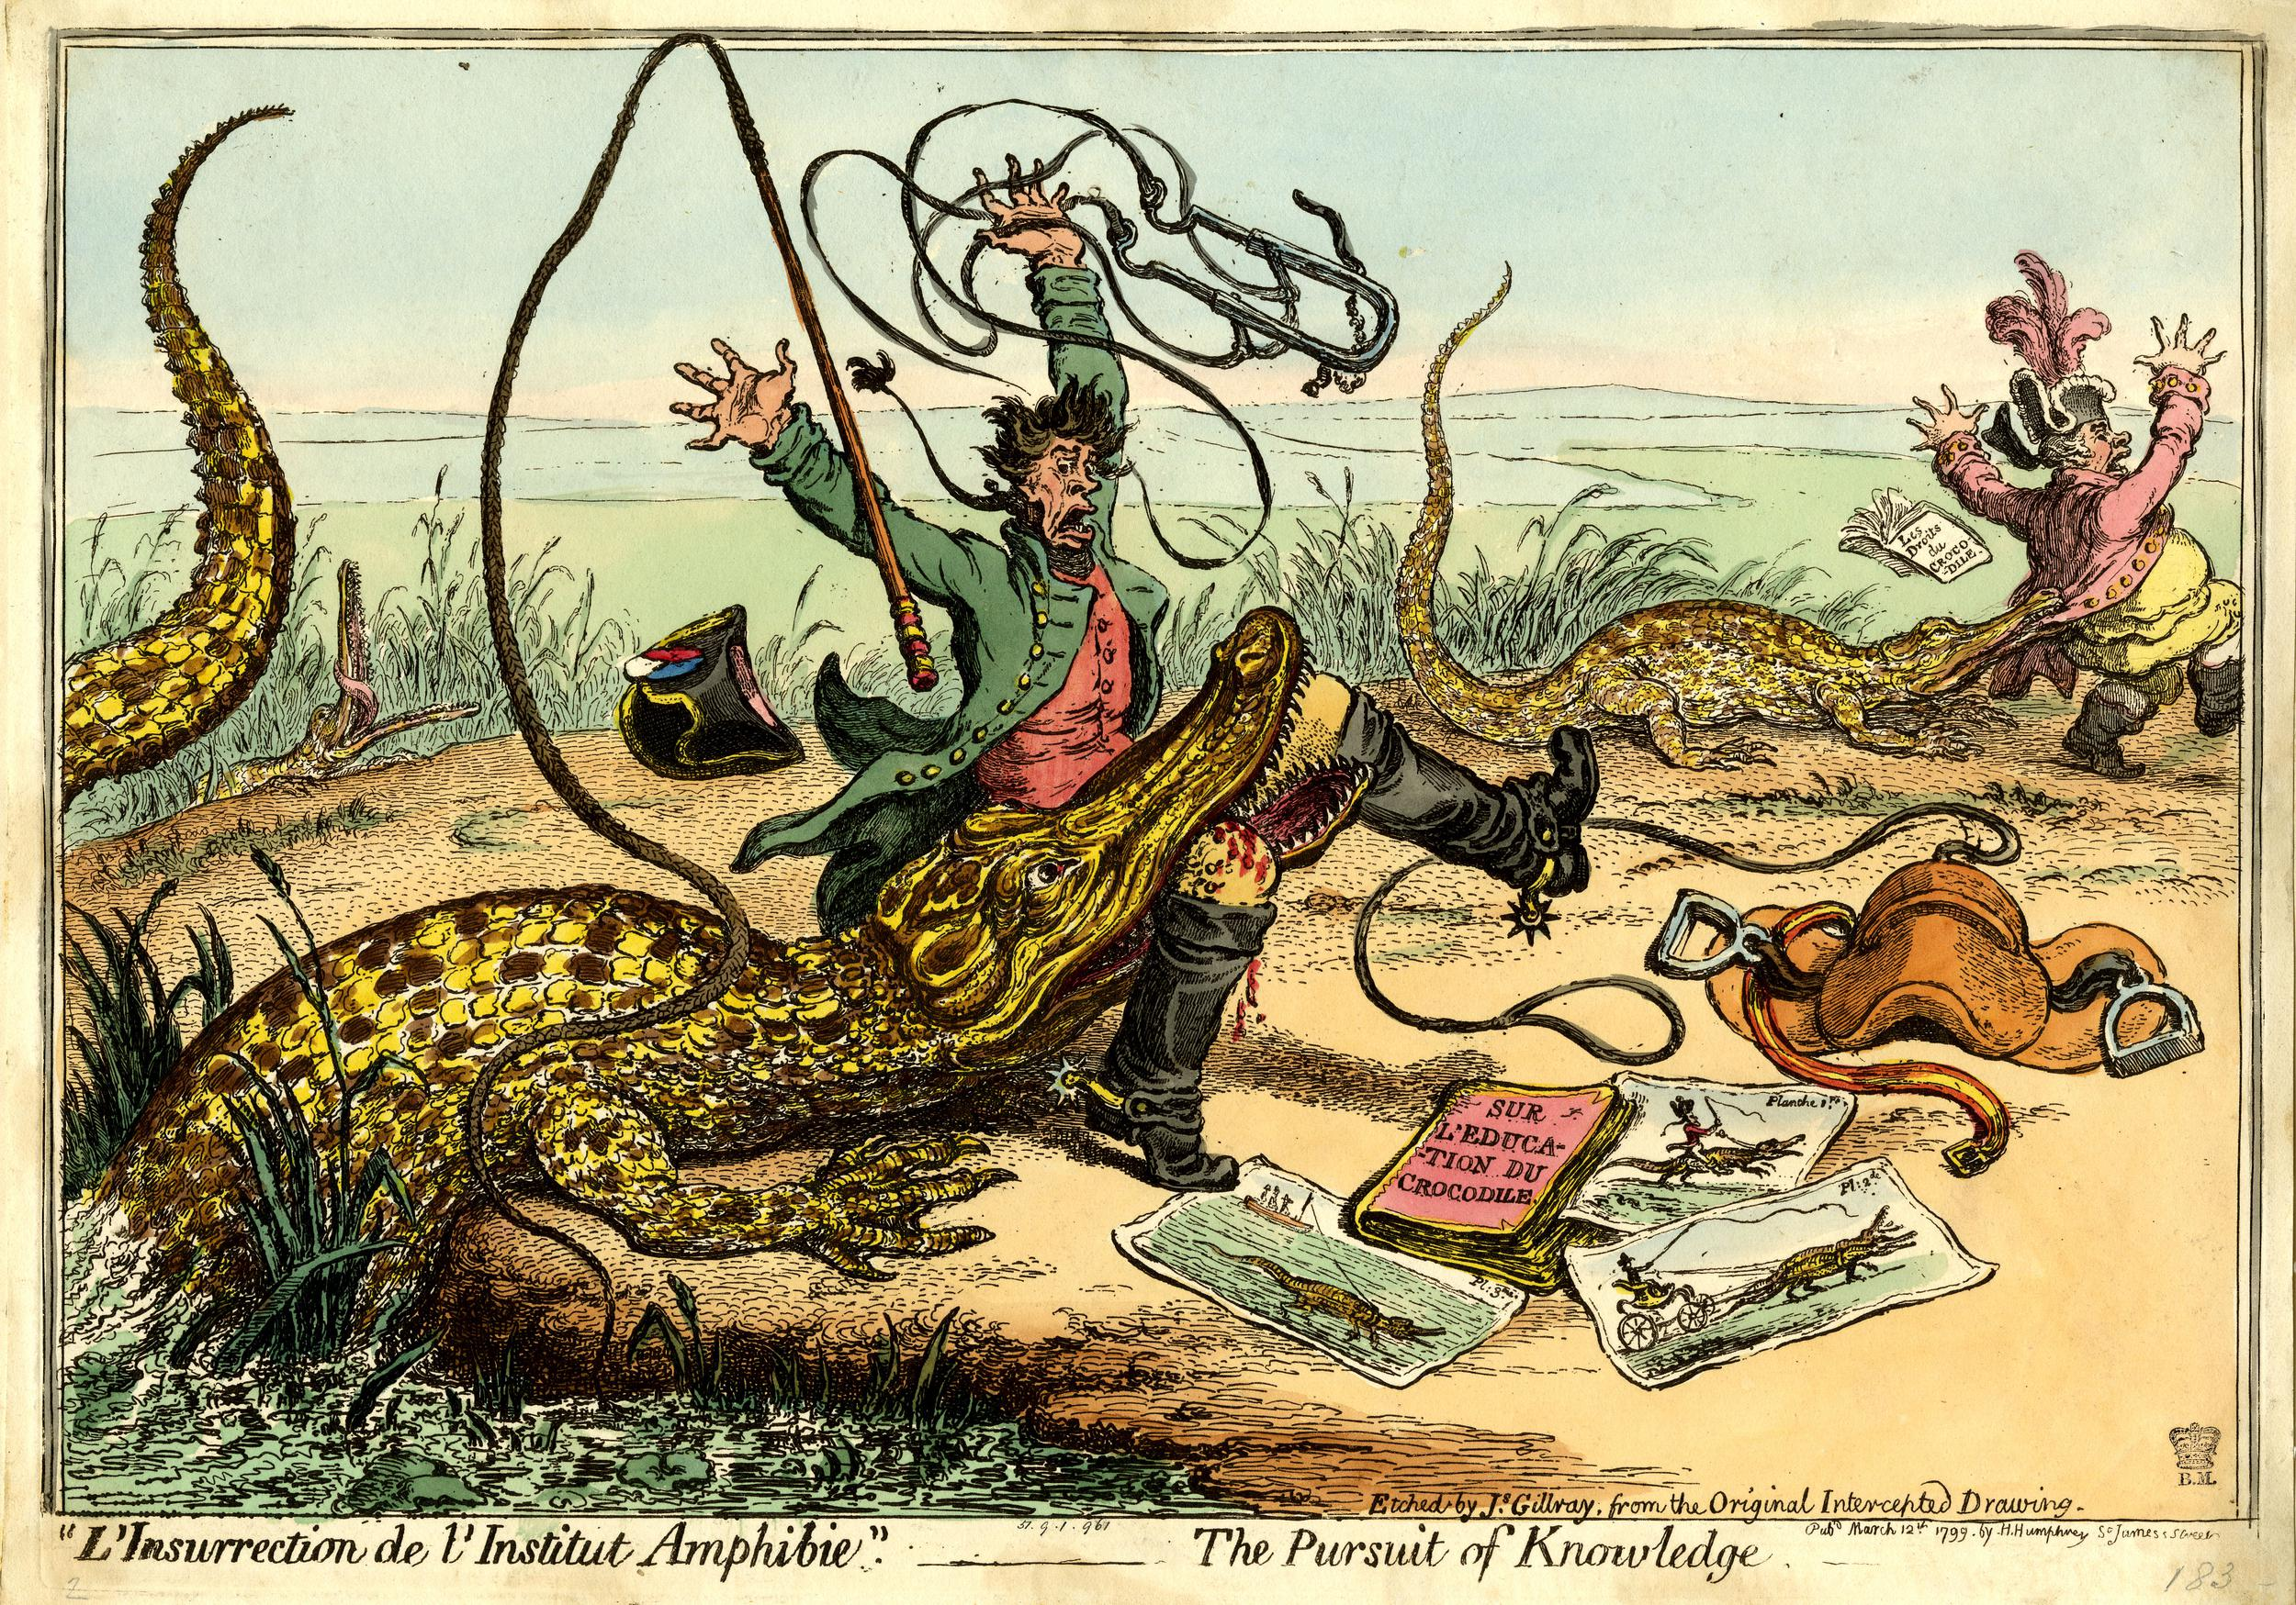
The LTS Domain

Slide 52
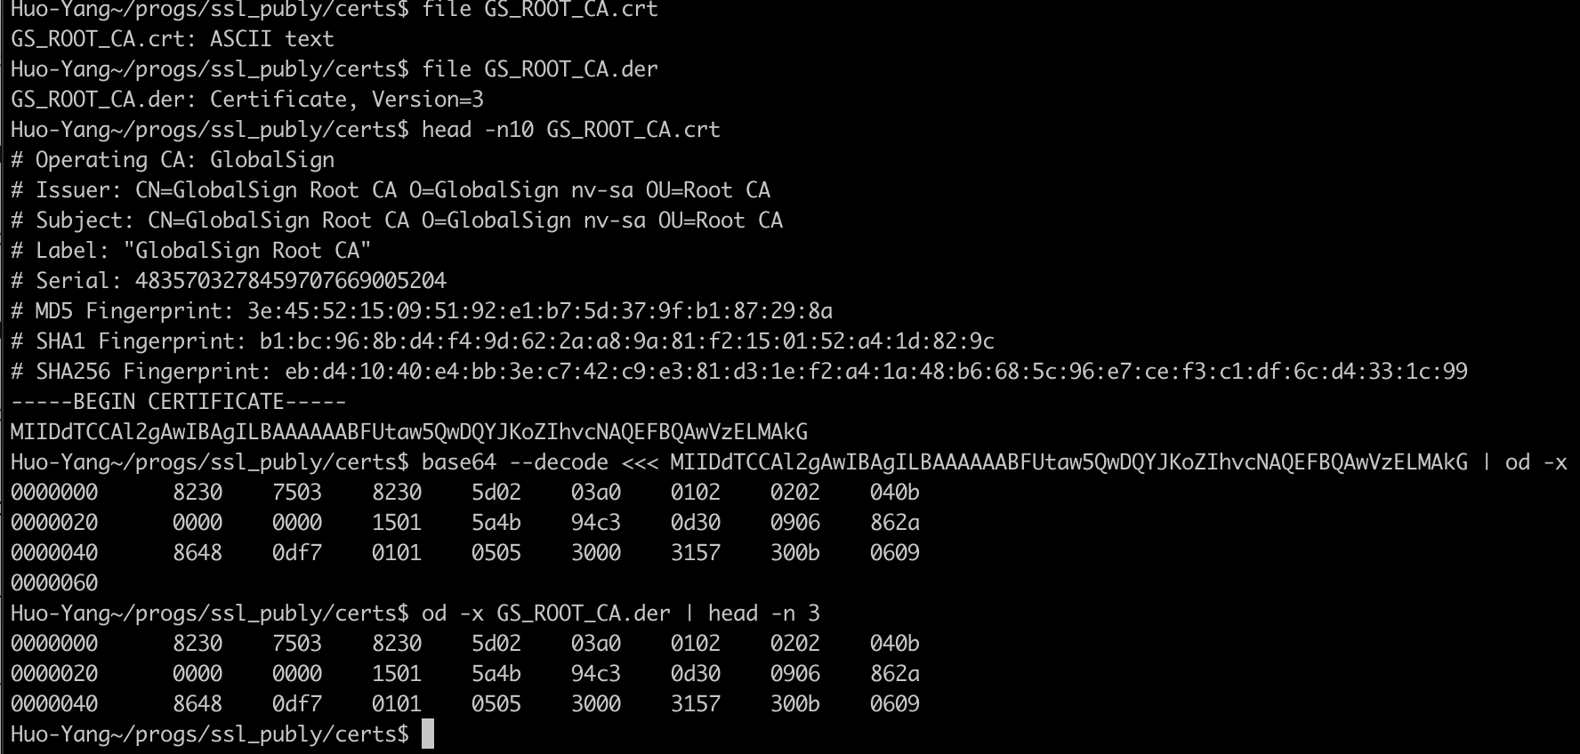
DER vs PEM (crt)

Slide 53
Datasheets
UBLOX SARAR4 AT Commands
SARA-R4 series AT commands manual - SARA-R4_ATCommands_UBX-17003787.pdf
Microchip Winc 1500
https://www.microchip.com/en-us/product/ATWINC1500#

Slide 54
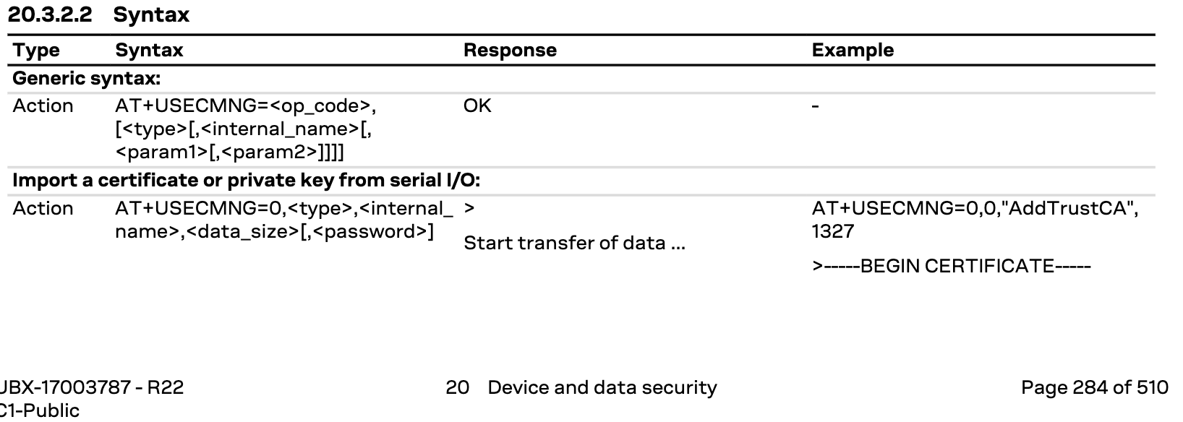
Ublox AT command to add cert

Slide 55
Ublox Cert data format
SARA-R410M-02B / SARA-R410M-52B / SARA-R410M-63B / SARA-R410M-73B / SARA-R410M-83B /
SARA-R412M / SARA-R422M8S / SARA-R422S / SARA-N4
Certificates and private keys both in DER (Distinguished Encoding Rules) and in PEM (Privacy-Enhanced Mail) format are accepted. If the provided format is PEM, the imported certificate or private key will be automatically converted in DER format for the internal storage. It is also possible to validate certificates and private keys. Up to 16 certificates or private keys can be imported.

Slide 56
Ublox Restrictions
The X.509 certificate DN (Distinguished Name) is composed of value fields which uniquely define an entity
being authenticated. For security reasons some limitations (related to DN fields) described below are
applied:
• The USECMNG import functionality allows the following DN value fields:
o commonName (http://oid-info.com/get/2.5.4.3)
o serialNumber (http://oid-info.com/get/2.5.4.5)
o countryName (http://oid-info.com/get/2.5.4.6)
o localityName (http://oid-info.com/get/2.5.4.7)
o stateOrProvinceName (http://oid-info.com/get/2.5.4.8)
o organizationName (http://oid-info.com/get/2.5.4.10)
o organizationalUnitName (http://oid-info.com/get/2.5.4.11)
o userID (http://oid-info.com/get/0.9.2342.19200300.100.1.1)
o domainComponent (http://oid-info.com/get/0.9.2342.19200300.100.1.25)
o pkcs9_emailAddress (http://oid-info.com/get/1.2.840.113549.1.9.1)
o pkcs9_unstructuredName (http://oid-info.com/get/1.2.840.113549.1.9.2)
• The import of an X.509 certificate with DN containing other value fields (not in the above list) will result
in an import error (error result code: USECMNG invalid certificate/key format).

Slide 57


Slide 58
Appendix - SSL Commands
openssl s_client -showcerts mqtt.googleapis.com:8883
openssl s_client -showcerts -servername mqtt.googleapis.com:8883 -connect mqtt.2030.ltsapis.goog:8883 </dev/null
openssl x509 -in azure.pem -text -noout
openssl asn1parse -in gtsltsr.crt -inform DER | less
nmap -p 8883 --script ssl-cert mqtt.googleapis.com

Slide 59
Appendix - Dictionary
C - Country Name (2 letter code) The two-letter country code where your company is legally located.
State or Province Name (full name) The state/province where your company is legally located.
Locality Name (e.g., city) The city where your company is legally located.
O - Organization Name (e.g., company) Your company's legally registered name (e.g., YourCompany, Inc.).
OU - Organizational Unit Name (e.g., section) The name of your department within the organization. (You can leave this option blank; simply press Enter.)
CN - Common Name (e.g., server FQDN) The fully-qualified domain name (FQDN) (e.g., www.example.com).
Email Address Your email address. (You can leave this option blank; simply press Enter.)
An optional company name Leave this option blank (simply press Enter).
S - subject
I - Issuer

Slide 60
Appendix - Capturing Network Traffic with WiFi
Some notes on the github link. Things to keep in mind
Use a fast machine to capture over wifi in monitor mode
Use the airmon tools to verify no processes are running which can disturb capture
Specify the correct channel
Position capture computer between router and device
Need to capture all five EAPOL messages to decode traffic
Most likely you will miss a packet and realize a tap is more efficient

Slide 61
Appendix - Openssl (and tools) man pages
https://www.openssl.org/docs/man1.0.2/man1/x509.html
https://www.openssl.org/docs/man3.0/man1/openssl.html

Slide 62
Appendix - URLS
PEM Spec
https://datatracker.ietf.org/doc/html/rfc1421
DIgiCert Quick Reference
https://www.digicert.com/kb/ssl-support/openssl-quick-reference-guide.htm
Free SSL Book
https://www.feistyduck.com/library/openssl-cookbook/online/ch-openssl.html
DigiCert CA’s
https://www.digicert.com/kb/digicert-root-certificates.htm
Wikipedia x509 cert
https://en.wikipedia.org/wiki/X.509
Wikipedia public key
https://en.wikipedia.org/wiki/Public_key_certificate
Oid
http://oid-info.com/get/2.5.4.3

Slide 63
Acknowledgements
Jim Gray - Greenstream
Dr. Burt Silverman - IBM Retired
Dario Pennisi - Arduino
Others whom I spoke with and helped me a along the way

